Slide 1

How to Win Budgets and Influence Stakeholders: Articulate Cyber Value to Non Technical Audiences
Jeremy Dorrough- RVAsec 14

Slide 2
“If you are not in the process of becoming the person you want to be, you are automatically engaged in becoming the person you don't want to be.”
Dale Carnegie

Slide 3
About Me
20 Years Cyber Security
Defense, Critical Infrastructure, Financial, Leadership, Sales
Presented at Defcon, UNC, JMU, FBI Infragard, RVAsec
Currently Client Director at Consortium

Slide 4
My Perspective
STUDENT
ENGINEER
BUYER
NEGOTIATOR

Slide 5
Overview of what I am going to cover
What is the problem? Who cares?
How most organizations are currently operating
How we as Cyber professionals can improve
Tools/Services to help us achieve better outcomes

Slide 6



Financial Reality Check
<
…$36,619,000
…575,000
…1575 Years
license.conf
Notes:
36,619,000
$64/day
Fiduciary duty

Slide 7
What’s the problem?
Cyber professionals speak a different language
Priorities often don’t align to business requirements
Red, Yellow, Green and 1-5
Measuring Cyber risk is hard
Notes:
>260

Slide 8
“The only way to influence people is to talk in terms of what the other person wants”
Dale Carnegie

Slide 9
Vernacular Matters
CVE-2014-0160
CVE-2017-0147
CVE-2017-0144
CVE-2021-44228
CVE-2023-34362

Slide 10
Vernacular Matters
Heartbleed
WannaCry
EternalBlue
Log4Shell/Log4j
MOVEit

Slide 11

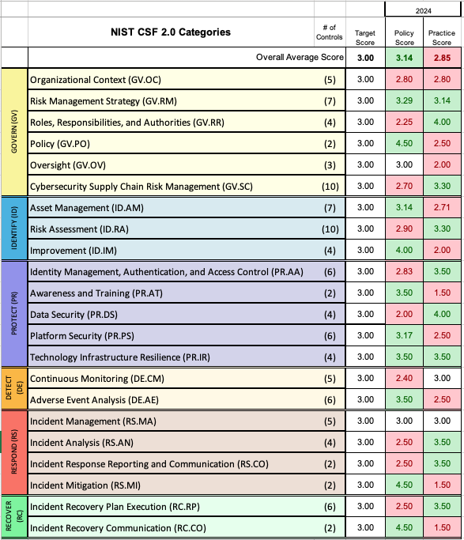
Red cost how much?

Slide 12
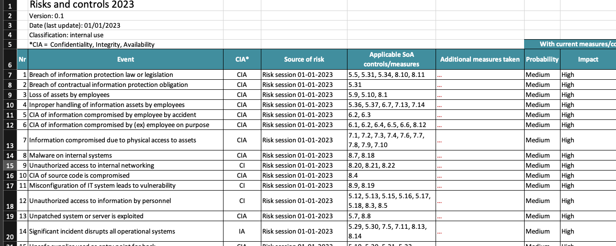
Is Medium High Better than High Medium?

Slide 13


Best Cyber Investment?
Identity
Tool 1
Endpoint
Tool 2
App Sec
Tool 3
Network
Grumpy Look
SOC
Tool 4
Risk MGMT
Tool 5

Slide 14
“It is true you are interested in what you want. But no one else is. The rest of us are just like you: interested in what we want.” Dale Carnegie

Slide 15
How are decisions made today?
Budgets are reverse engineered to solutions
Hype cycles influence procurement
Who has stronger personal relationship with budget holder
Use it or lose it motivational spending

Slide 16

Chicken Little

Slide 17
“Do the hard jobs first. The easy jobs will take care of themselves”
Dale Carnegie

Slide 18
Things to consider
Must use a consistent Risk Framework (NIST, ISO27001, etc)
Create/Maintain Risk Register
Know your audience and adapt messaging accordingly
Cyber practitioners must learn business mechanics and true value drivers
There will always be residual risks

Slide 19
Financial Fundamentals
Capital Expense (CapEx) vs Operational Expense (OpEx)
Depreciation lifecycle
Financing terms
Payment terms (Net 90, Annual, Balloon)
License terms (Perpetual, Annual, SAAS)
Budget Delta

Slide 20
How to breakdown the technical divide
Business Metrics vs Cyber KPI
Productivity Improvements
Outage Costs
Stock Impact
Personal Liability (CEO, Board, CISO)
Notes:
Target CEO, HIPPA and GDPR board responsibility, CISO Solarwinds and Uber

Slide 21
“An hour of planning can save you 10 hours of doing”
Dale Carnegie

Slide 22

Defensible data > Subjective feelings
Cost?
Reduce risk? ($$$)
Proof of Metrics?
Best use of budget?

Slide 23

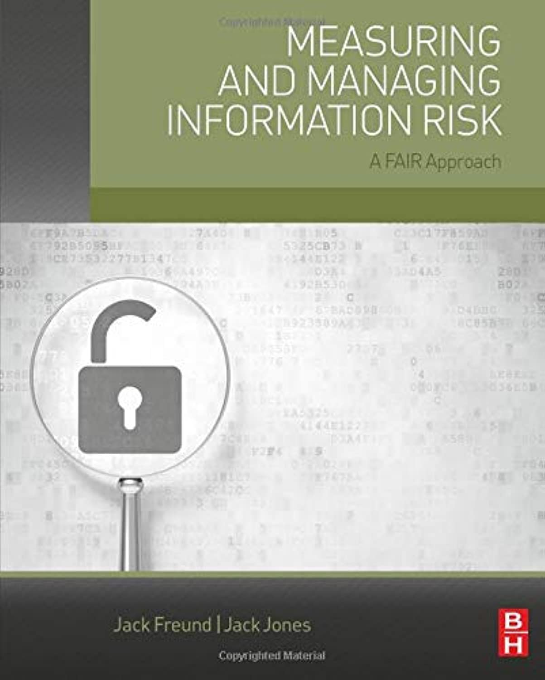
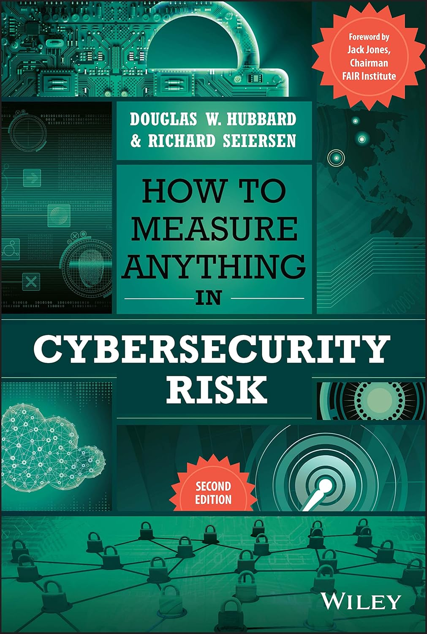
Resources to help measure Risk/Effectiveness
Gordon and Loeb Model (GL Model)
FAIR Institute training
Modify Risk Framework to include custom costs categories
Cyber event cost spreadsheets (Outage, remediation, brand impact)

Slide 24
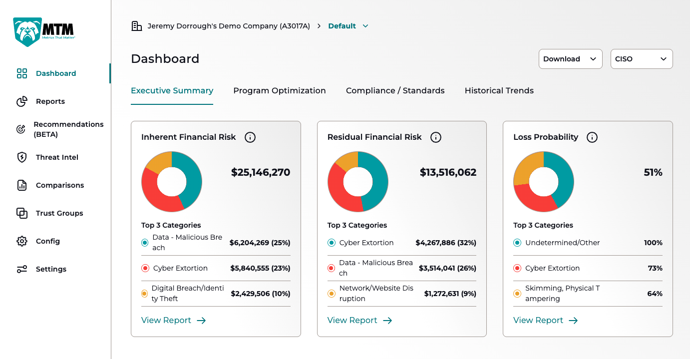
3rd Party Tools
Vendor Tools
Risk Assessment, FAIR, Tools Rationalization
PenTests / Tabletop Services

Slide 25
Closing Summary
Align closer to business objectives
Speak in universally understood vernacular
Understand the limitations of Cyber Risk Frameworks
Make decisions based on defensible data
Develop internal or leverage vendor tools to measure cost effectiveness

Slide 26
“Knowledge isn’t power until it is applied”
Dale Carnegie

Slide 27

Questions

